Slide 1
Urry Group Weekly Update
June 19th 2017

Slide 2
Last “Week”
HST panel . . .
Discovered Issue with Selection
Investigated Luminous Red Galaxies as potential cross-correlation sample

Slide 3
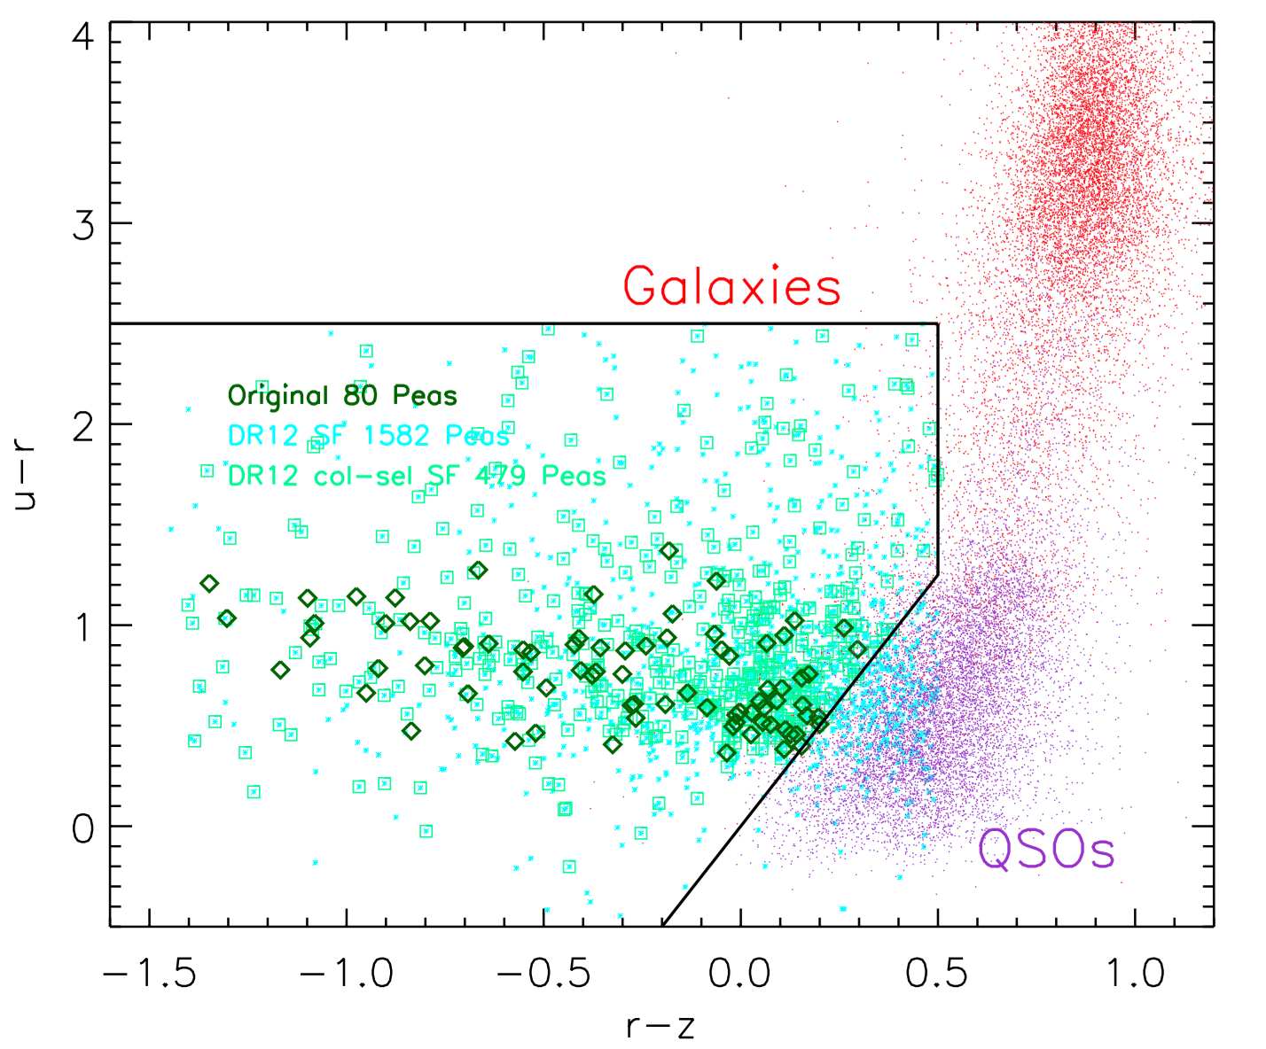
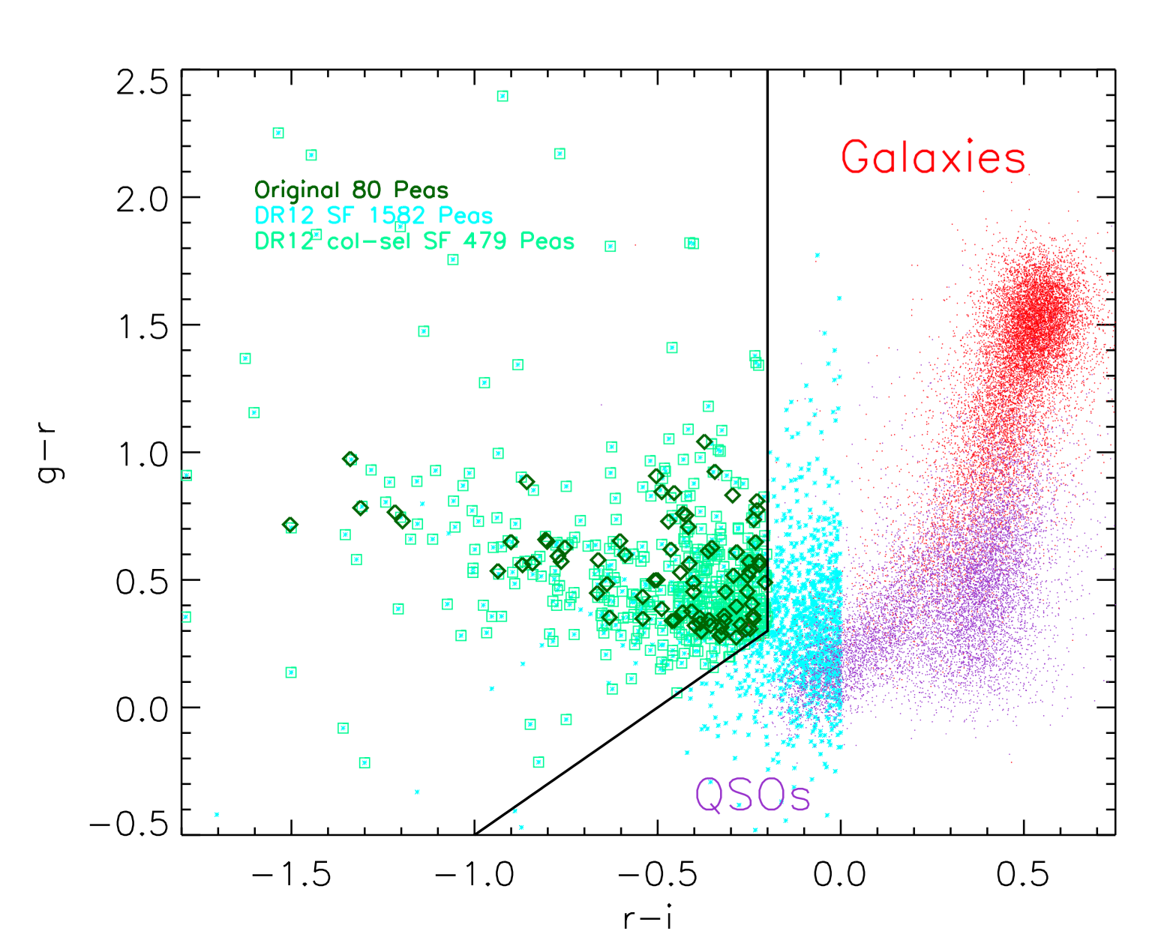
Peas Search in DR12 (old #s)
DR12 (color & size): 849 (4155 )
DR12 Portsmouth Group: 727 (2203)
DR12 Portsmouth Group SF: 479 (1592 )
DR12 Portsmouth Group SF & clean phot: 431(1454)
DR12 A/N gt 3 in all lines: 214 (739)

Slide 4
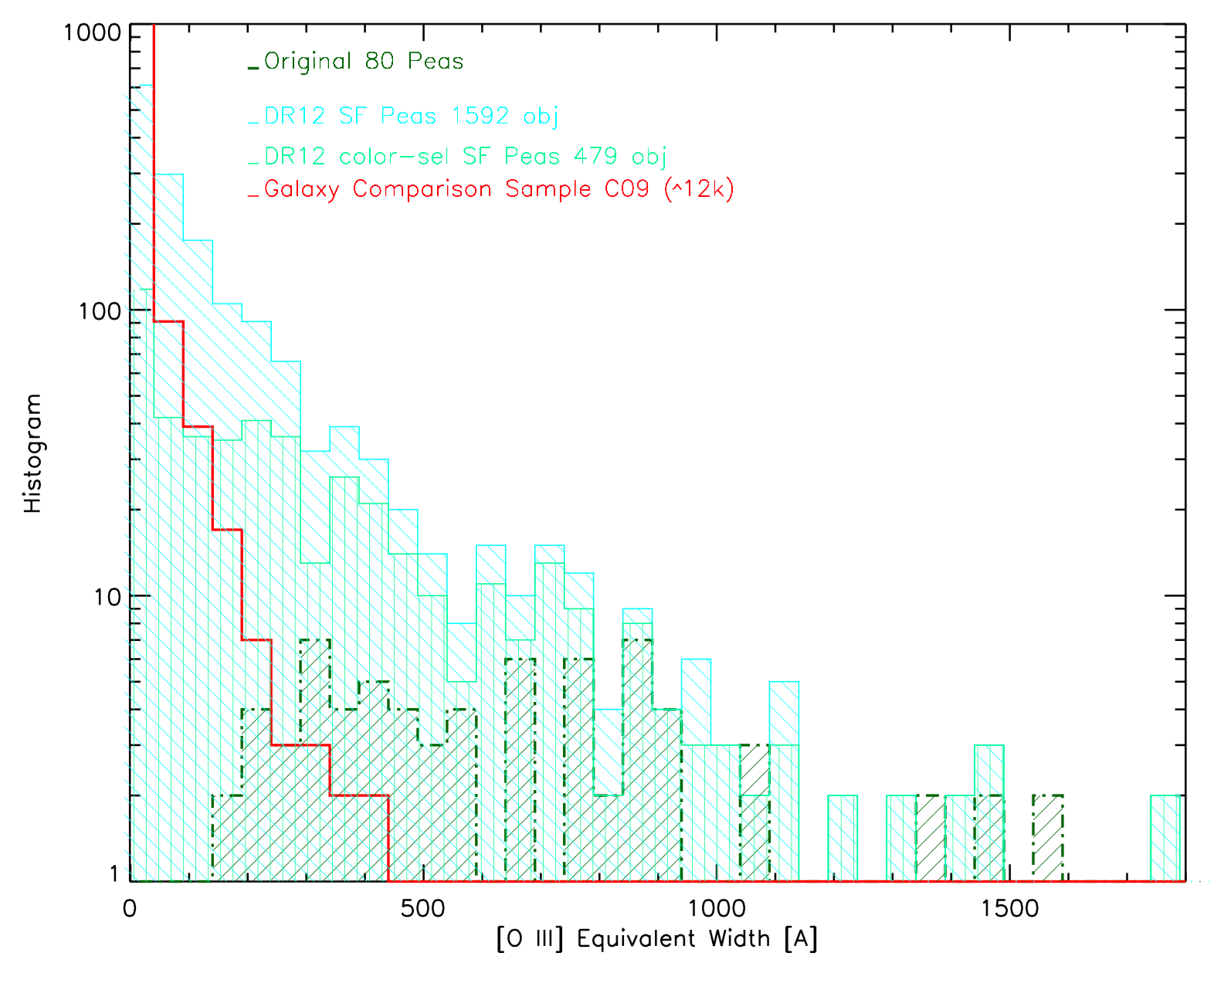
Huge tail of v. low OIII lines,
Mitigated w/ improved col sel
original 80 peas smallest OIII EW is 12.6
New Peas follow more galaxy-like distribution of OIII

Slide 5
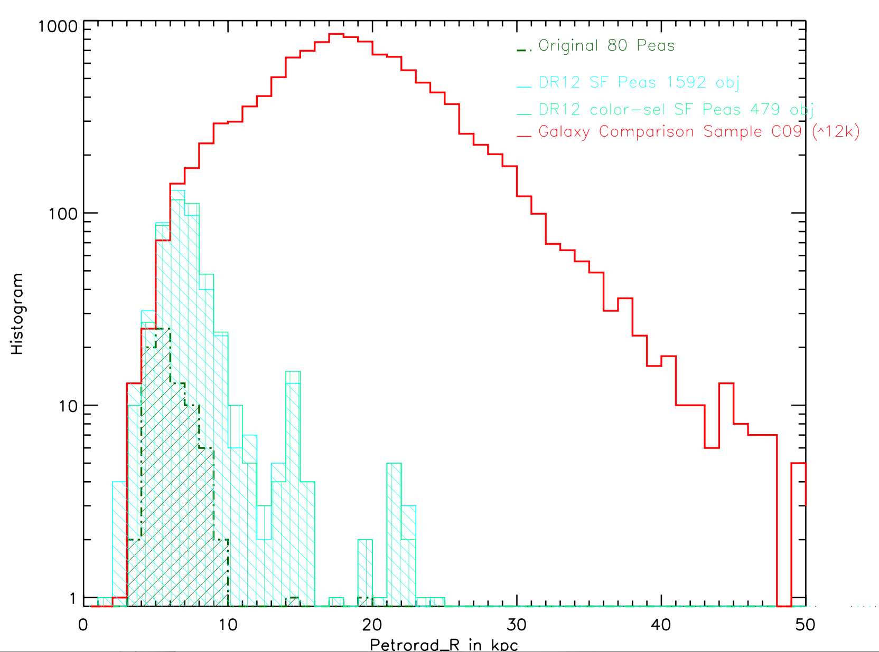
Huge tail of large sizes,
Mitigated w/ improved
but still there col sel

Slide 6
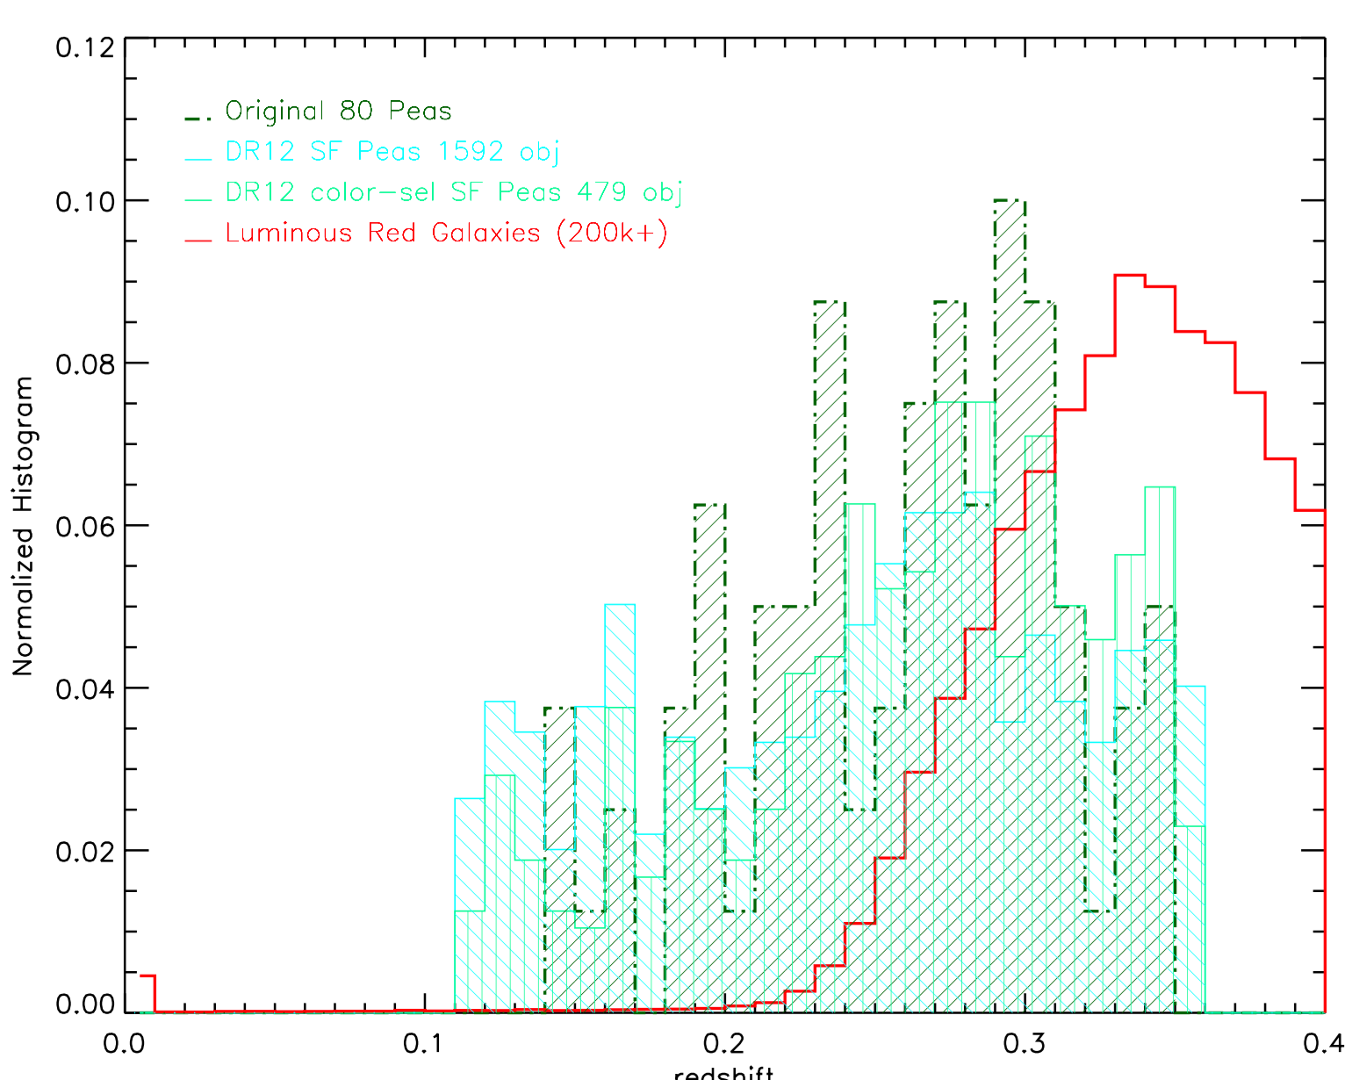
Luminous Red Galaxies doesn’t match z distribution (861 from 0.1<z<0.2, 168k to z<0.36)

Slide 7
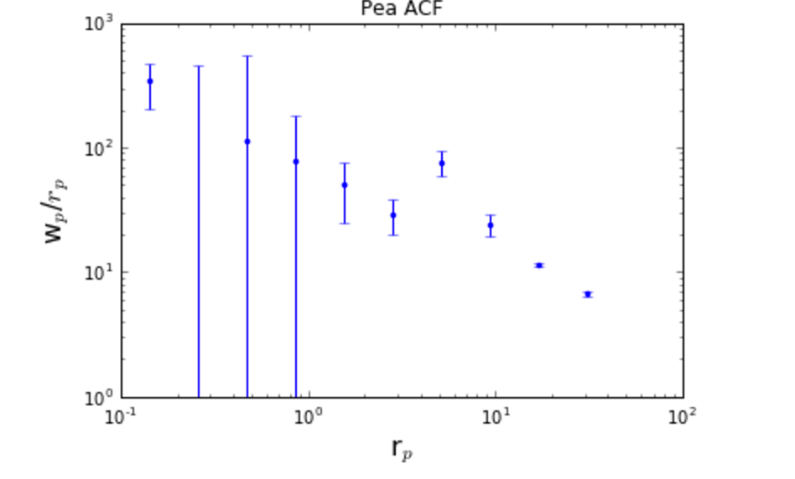
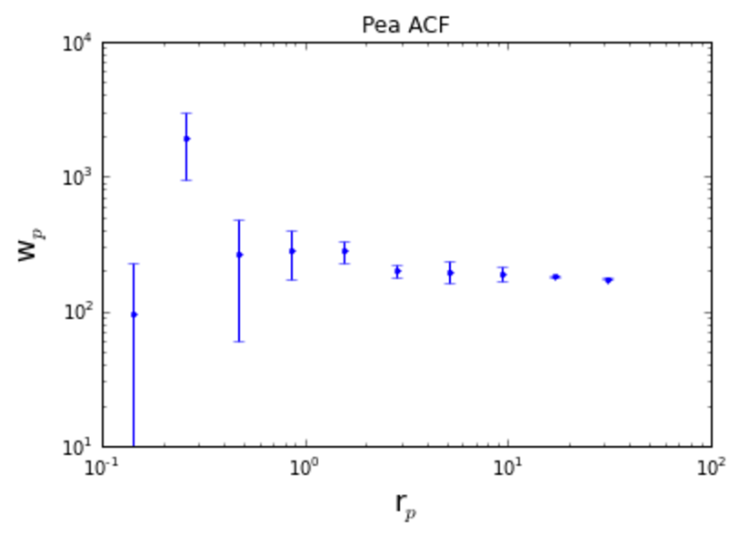
479 peas - not enough for ACF?
1500 objects – selected impurely

Slide 8
Next Steps:
(On my laptop)
Fix errors on correlation function code
Generate random catalog for LRGs
Run cross-correlation of LRGs
Learn correlation code from Merry
Add to ‘memo’ document notes about new sample & edit introduction to

Slide 9
HST Search - PEAS
63 of the 1346 ‘new’ BOSS peas are in HST imaging + 11 of the 24 original peas not in BOSS search result
Trying to get actual data now….
Recent proposals:
Lyman alpha escape in Green Pea galaxies (give peas a chance)
Green Pea Galaxies: Extreme, Optically-Thin Starbursts?
UV Spectroscopy of Lyman Break Galaxy Analogs: A Local Window on the Early Universe
Origin of double peaks in Lyman-alpha spectra: diffuse halos or Lyman continuum leakage?
Unveiling the Dark Baryons II: the First Sample of OVI Emission Imaging
UV Snapshot of Low-redshift Massive Star-forming Galaxies: Searching for the Analogs of High-redshift Clumpy Galaxies

Slide 10
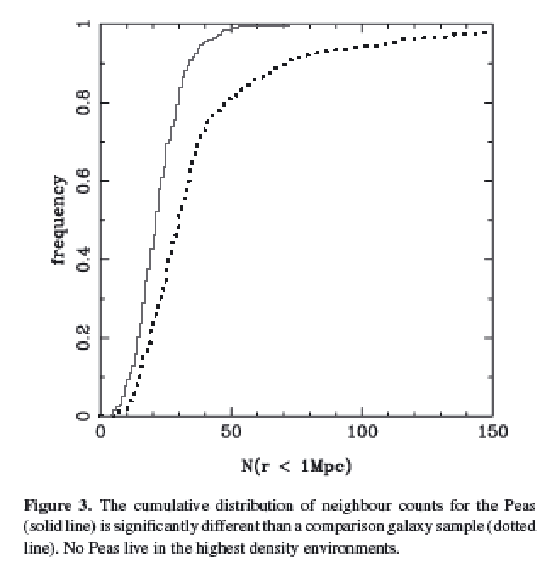
Cardamone et al. 2009
Projected density around Peas vs. sample matched in luminosity and redshift
Looked within projected 1Mpc, and imag > -20.5
Notes:
Projected density around Peas vs. sample matched in luminosity and redshift
Looked within 1Mpc, and imag > -20.5
Peas lie in lower density regions than typical gal at same i-band luminosity
KS test 8 sigma
Median environmental density less than 2/3rds normal galaxies

Slide 11
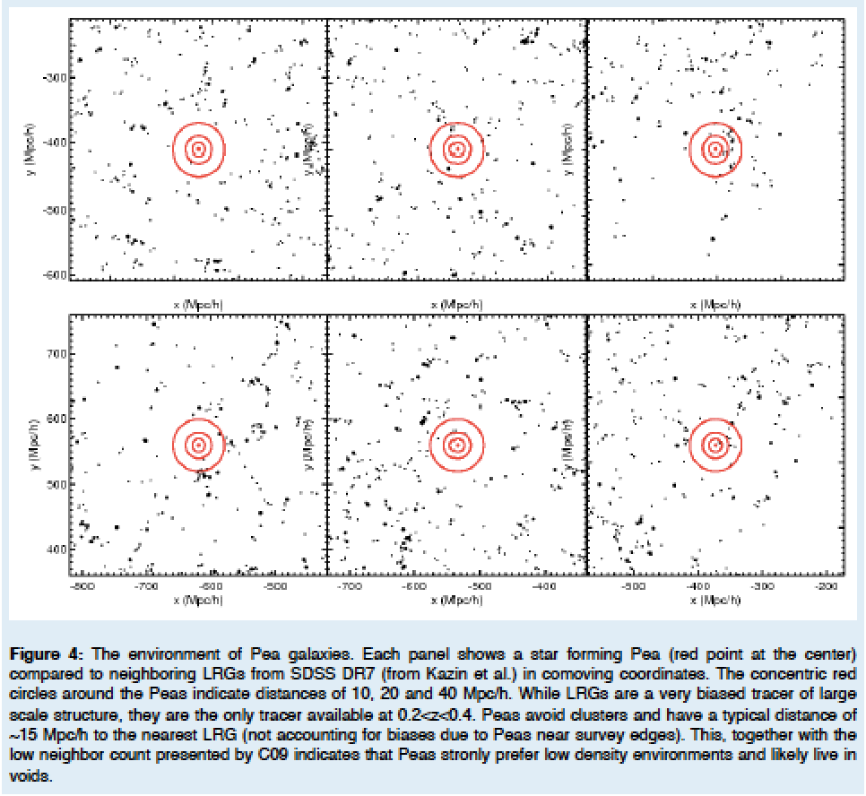
Kevin’s HST SNAP proposal / ~15 Mpc/h to nearest DR7 LRGs
Notes:
(10,20 & 40 Mpc/h) – red circles
Strongly prefer low density environments. . . .

Slide 12
Mapping Environment of Green Peas
Original idea – match peas to a Mock Universe
Looking at abundance matching
e.g., distance to 5th nearest neighbor (W/in Mstar)
e.g., distribution of Neighbors within 1/5 Mpc

Slide 13
Searching for Pea Neighbors
Starting with the original sample of 80 peas, looking within 50 Mpc projected
Neighbors found with specz 427
Neighbors in photometric catalog 120595
Neighbors found with photo redshift est 20743
Neighbors found w/ photoz in 1sig of pea z 9844
+ -> photo error class 1 3560
*** only a handful (35) remain if looking within 5 Mpc… ***

Slide 14
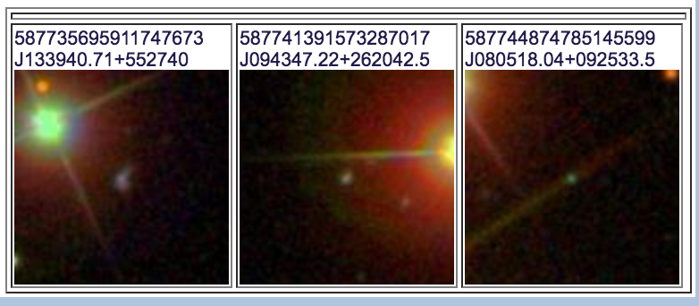
8 from Original 80 not recovered
3 BAD photometry – near bright objects….
2 not in Portsmouth Catalog
3 had EW < 0.5
15 Not classified as ‘Star Forming’ in BPT
(Seyfert, Composite, LINER)

Slide 15
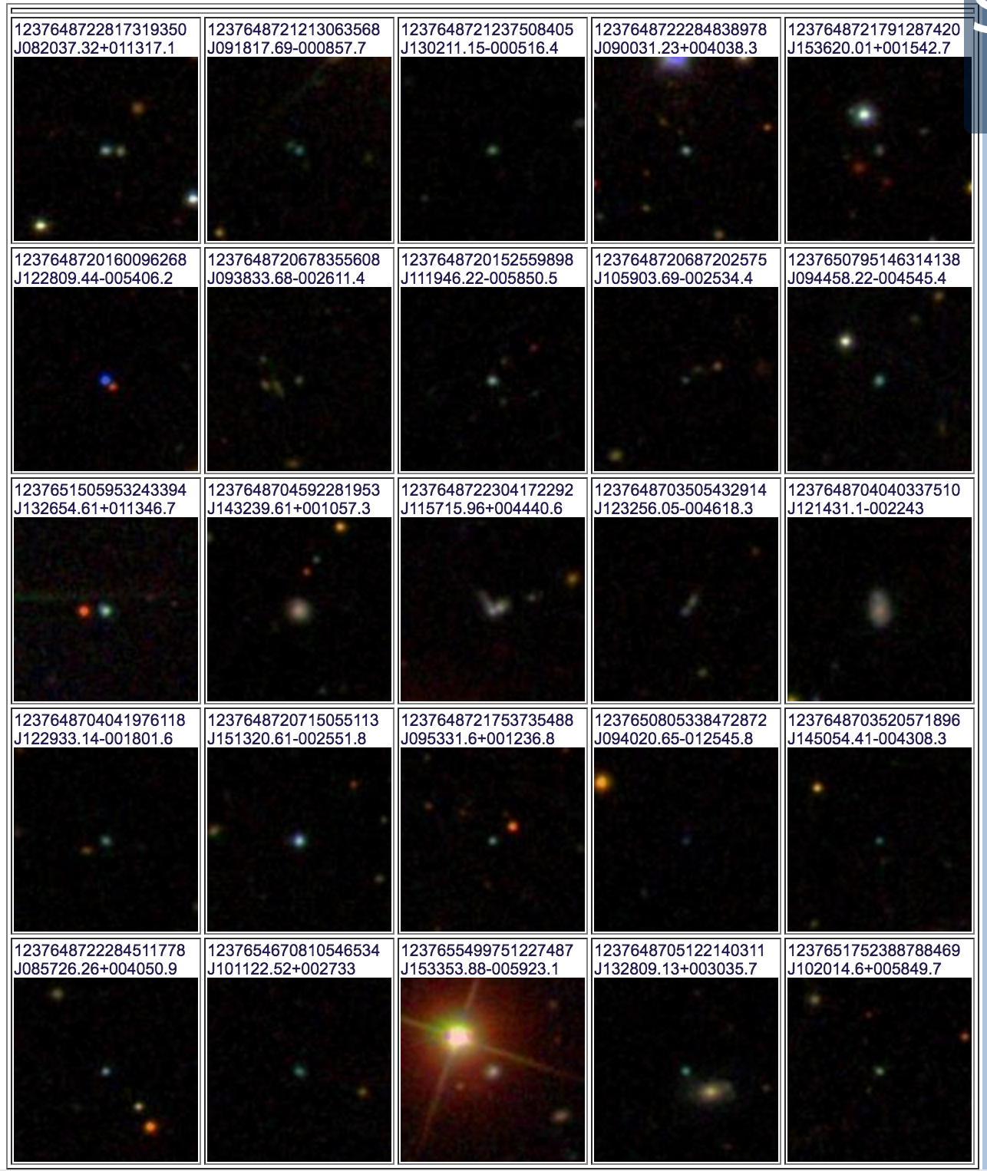
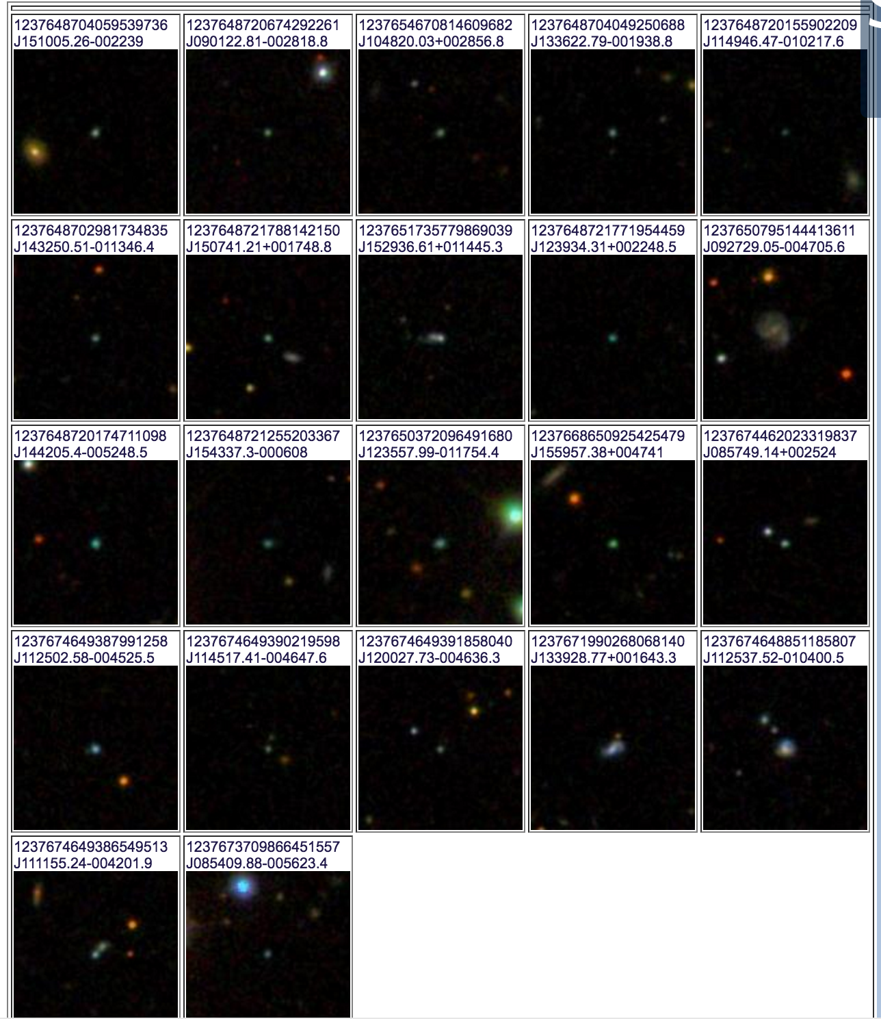
Images of peas Stripe 82

Slide 16
